Slide 1
Attention-based text summarization

Slide 2
Attention-based text summarization
commonly implemented using an Encoder–Decoder architecture with an attention mechanism.
encoder reads the input document and the decoder generates the summary one word at a time.

Slide 3
Basic Architecture
Consider the document: “The university conducted an artificial intelligence workshop for students. The workshop introduced machine learning and deep learning concepts.”
Desired summary: “University conducted an AI workshop on machine learning.”
The architecture is:
Input document → Encoder → Attention → Decoder → Summary
The encoder processes each input word and produces a hidden representation
The important point is that the decoder does not need to rely on a single encoder vector. Attention allows it to look at the most relevant encoder states at every decoding step.

Slide 4
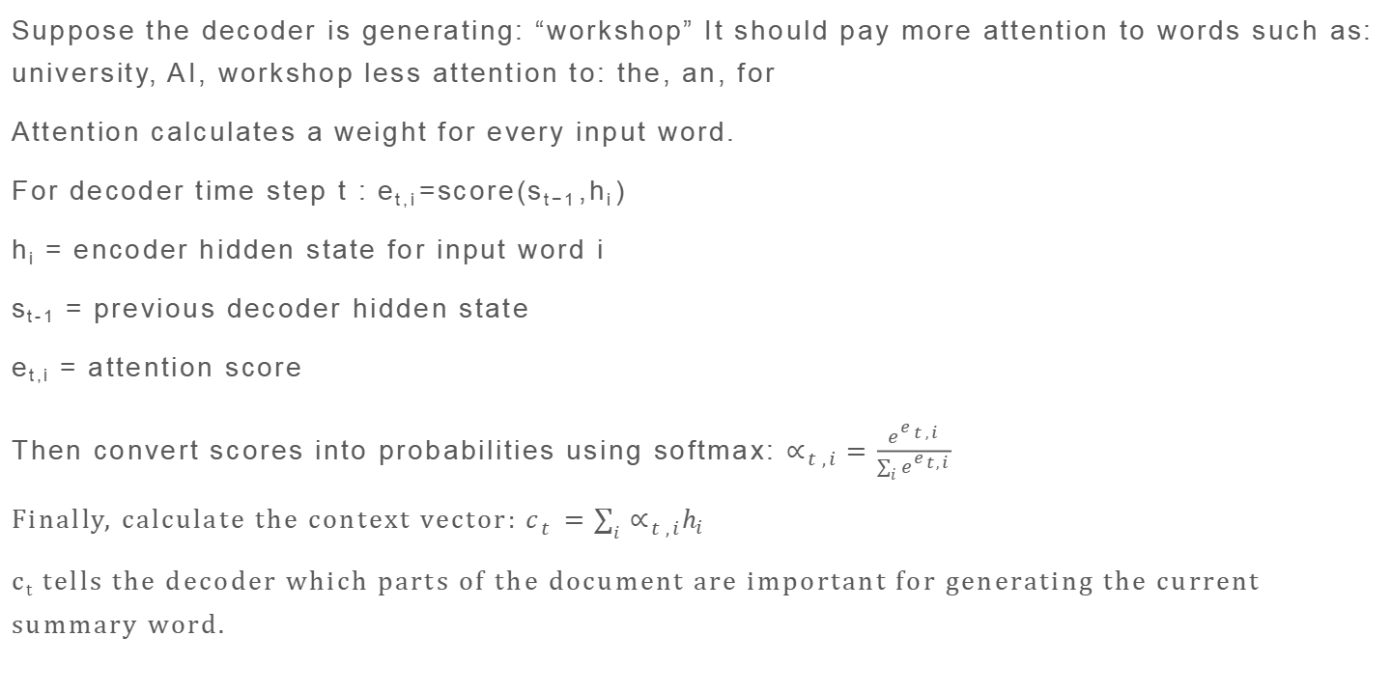
What Does Attention Do?
Suppose the decoder is generating: “workshop” It should pay more attention to words such as: university, AI, workshop less attention to: the, an, for
Attention calculates a weight for every input word.
For decoder time step t : e_{t,i}​=score(s_{t−1}​,h_{i}​)
h_{i} = encoder hidden state for input word i
s_{t-1} = previous decoder hidden state
e_{t,i} = attention score
Then convert scores into probabilities using softmax: $∝_{t,i}=\frac{e^{e_{t,i}}}{\sum_{i}{e^{e_{t,i}}}}$
Finally, calculate the context vector: $c_{t}=\sum_{i}{∝_{t,i}h_{i}}$
c_{t} tells the decoder which parts of the document are important for generating the current summary word.

Slide 5
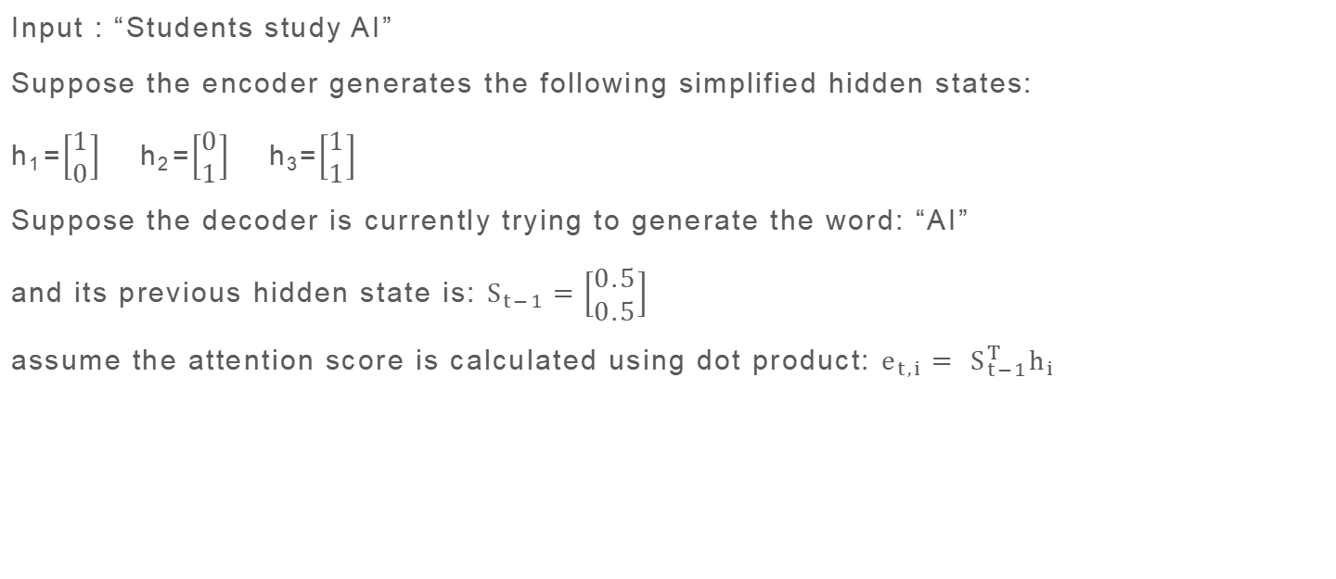
Example
Input : “Students study AI”
Suppose the encoder generates the following simplified hidden states:
h₁​=$\left[\begin{matrix}1 \\ 0\end{matrix}\right]$ h₂​=$\left[\begin{matrix}0 \\ 1\end{matrix}\right]$ h₃=$\left[\begin{matrix}1 \\ 1\end{matrix}\right]$
Suppose the decoder is currently trying to generate the word: “AI”
and its previous hidden state is: $S_{t−1}=\left[\begin{matrix}0.5 \\ 0.5\end{matrix}\right]$
assume the attention score is calculated using dot product: $e_{t,i}= S_{t−1}^{T}h_{i}$

Slide 6
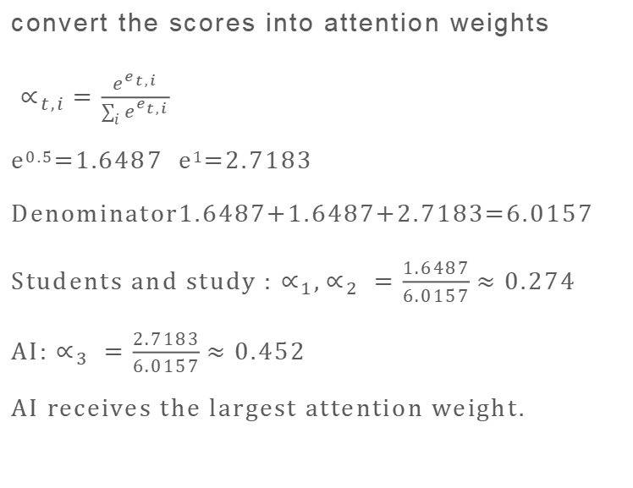
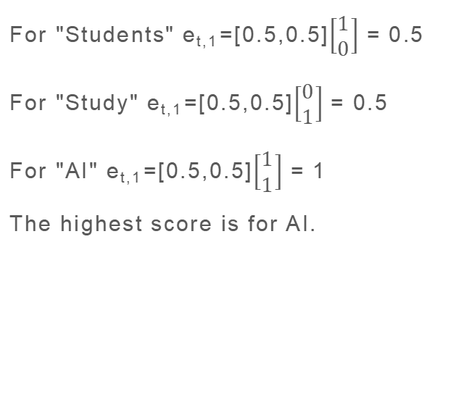
Attension Mechanism
Step 1: Calculate Attention Scores
Step 2: Apply Softmax
For "Students" e_{t,1}​=[0.5,0.5]$\left[\begin{matrix}1 \\ 0\end{matrix}\right]$ = 0.5
For "Study" e_{t,1}​=[0.5,0.5]$\left[\begin{matrix}0 \\ 1\end{matrix}\right]$ = 0.5
For "AI" e_{t,1}​=[0.5,0.5]$\left[\begin{matrix}1 \\ 1\end{matrix}\right]$ = 1
The highest score is for AI.
convert the scores into attention weights
$∝_{t,i}=\frac{e^{e_{t,i}}}{\sum_{i}{e^{e_{t,i}}}}$
e^{0.5}=1.6487 e¹=2.7183
Denominator1.6487+1.6487+2.7183=6.0157
Students and study : $∝_{1},∝_{2} =\frac{1.6487}{6.0157}≈0.274$
AI: $∝_{3} =\frac{2.7183}{6.0157}≈0.452$
AI receives the largest attention weight.

Slide 7

Attension Mechanism
Step 3: Calculate Context Vector
Step 4: Decoder Generates the Word
c_{t}​=0.274 $\left[\begin{matrix}1 \\ 0\end{matrix}\right]$+0.274 $\left[\begin{matrix}0 \\ 1\end{matrix}\right]$+0.452 $\left[\begin{matrix}1 \\ 1\end{matrix}\right]$
C_{t}=$\left[\begin{matrix}0.726 \\ 0.726\end{matrix}\right]$
This is the attention context vector used by the decoder.
The decoder combines: previous decoder state s_{t-1} ,attention context c_{t} to produce the next decoder state: s_{t}​=f(s_{t−1}​,c_{t}​,y_{t−1}​)
In a real LSTM/GRU decoder, this involves the corresponding recurrent equations.
The decoder then applies a softmax layer:
P(y_{t}​∣y_{<t​},x)=softmax(W_{s}​s_{t}​+b)
The highest probability is: AI
​Therefore the decoder generates: AI

Slide 8
Complete Summarization Process
Time step 1
Time step 2
Word | Attention
Students | 0.5
study | 0.3
AI | 0.15
machine | 0.03
learning | 0.02
Generated word: Students
Word | Attention
Students | 0.1
study | 0.15
AI | 0.45
machine | 0.15
learning | 0.15
Generated word: AI

Slide 9
Complete Summarization Process
Time step 3
Final output
Word | Attention
Students | 0.05
study | 0.05
AI | 0.10
machine | 0.35
learning | 0.45
Generated word: Learning
The decoder eventually produces:
“Students study AI and machine learning.”
For a longer document, it may instead produce a shorter abstractive summary such as:
“Students learn AI and machine learning.”

Slide 10
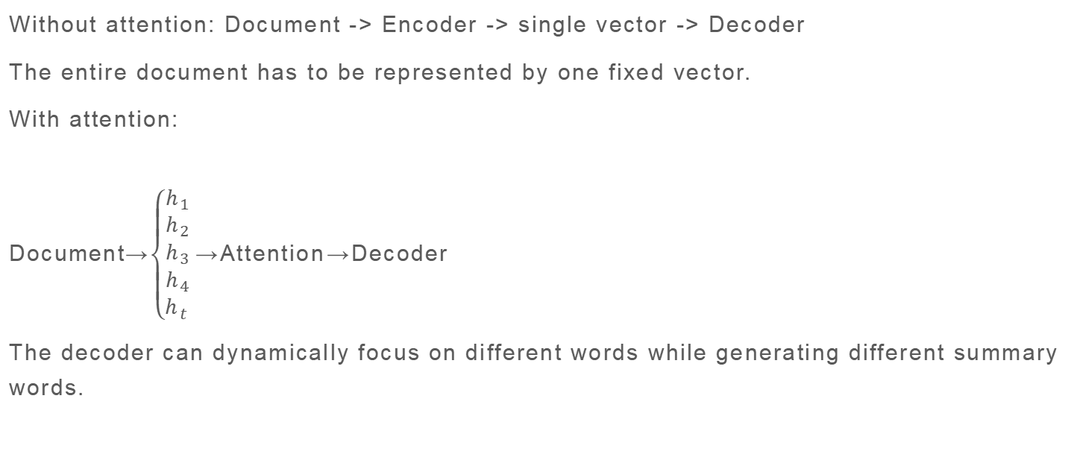
Why Attention Improves Summarization
Without attention: Document -> Encoder -> single vector -> Decoder
The entire document has to be represented by one fixed vector.
With attention:
Document→$\left\{\begin{aligned}h_{1} \\ h_{2} \\ \begin{aligned}h_{3} \\ h_{4} \\ h_{t}\end{aligned}\end{aligned}\right.$​​→Attention​→Decoder
The decoder can dynamically focus on different words while generating different summary words.

Slide 11
complete mechanism
Encoder states→ Attention Scores→Softmax Weights→Context Vector→Decoder→Next Summary Word

